Slide 1





GIT SETUP
Fauzi Sholichin
fauzisholih@gmail.com
+6289673732142
https://www.linkedin.com/in/fauzisho/

Slide 2
Introduction
Create a New Repository
Bitbucket (https://bitbucket.org)
or
Github (https://github.com/)

Slide 3
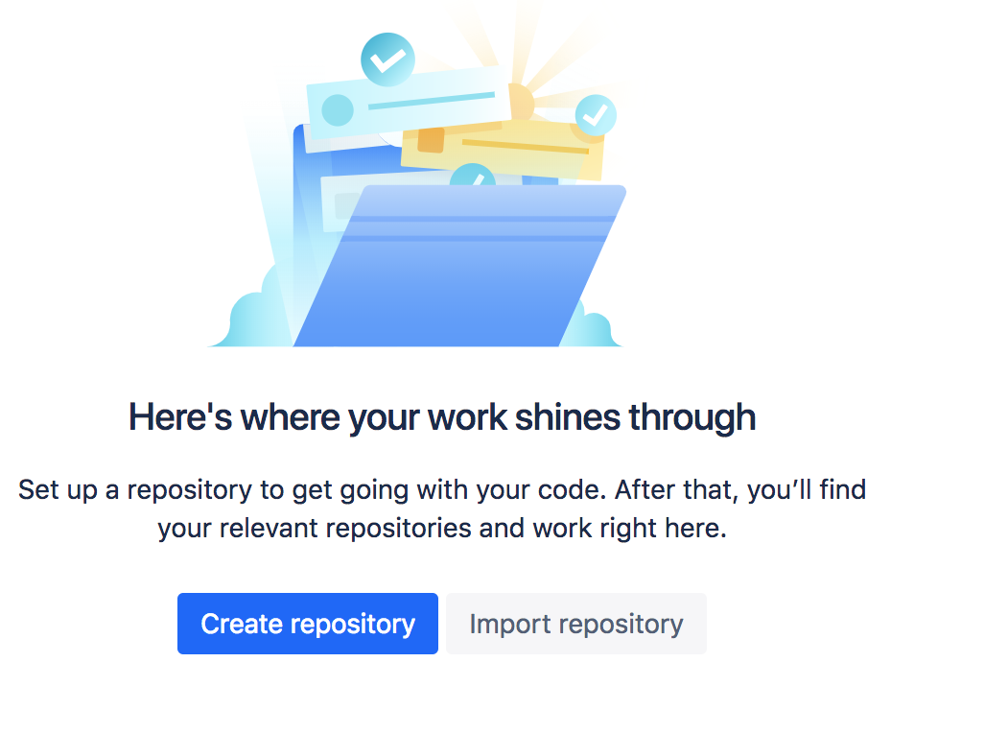
Bitbucket
Open (https://bitbucket.org)
Login with your email
Create Repository

Slide 4
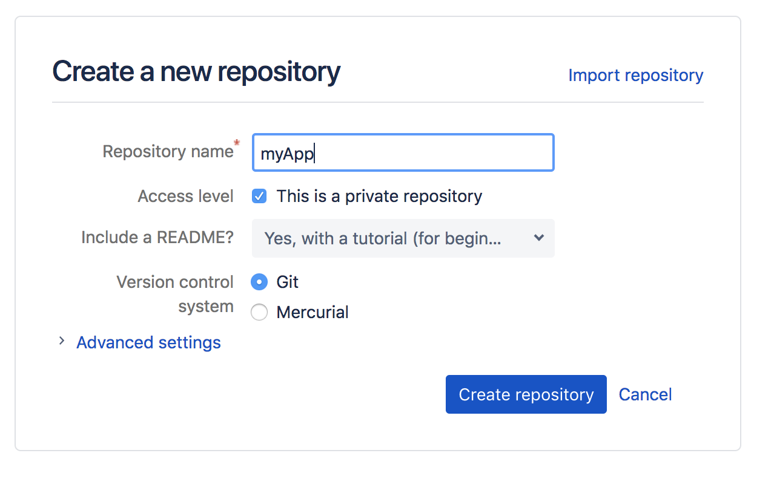
Bitbucket
4. Create a new repository (example : myApp)

Slide 5
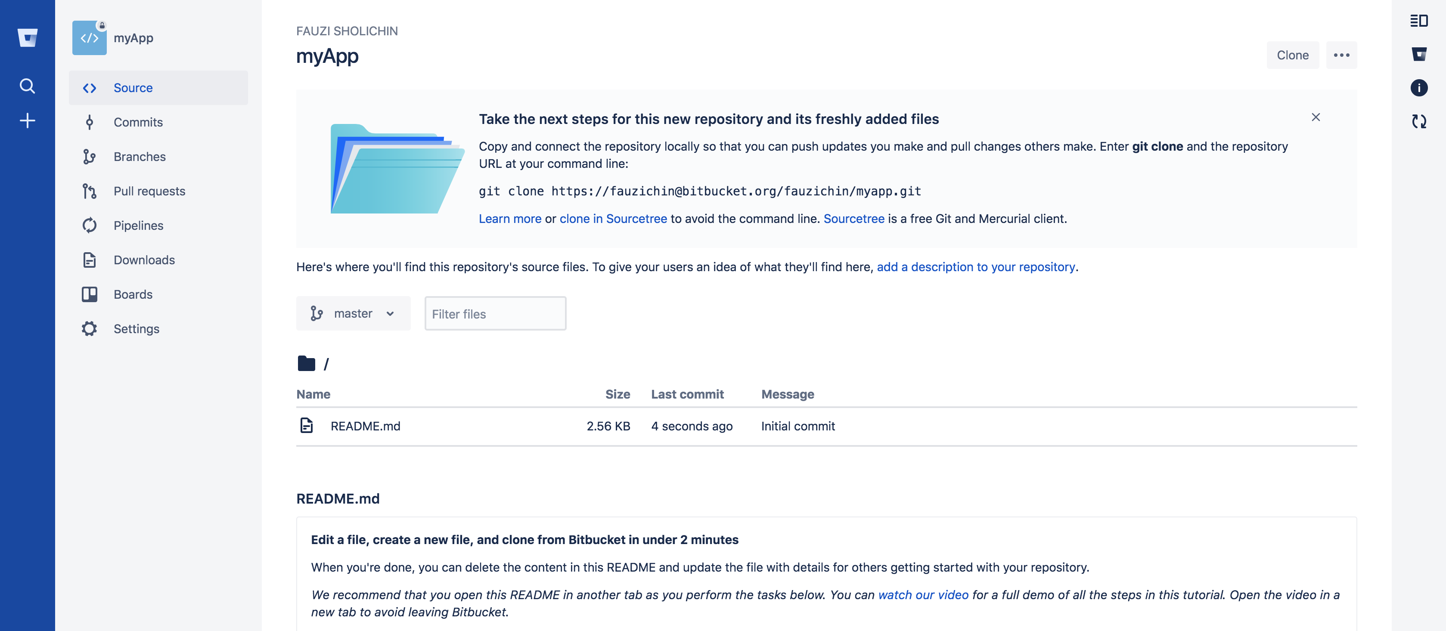
Bitbucket
4. Your repository :

Slide 6
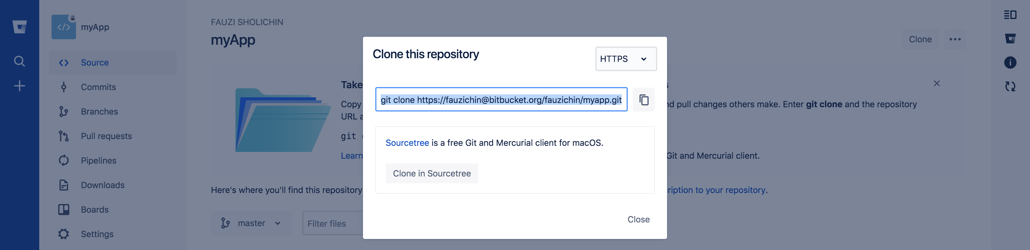
Get your HTTPS / SSH Access

Slide 7
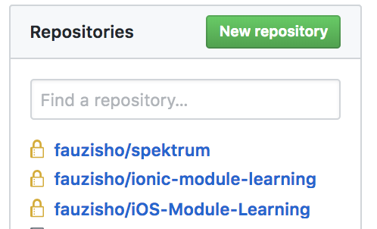
Github
Open github (https://github.com/)
Login
Create new repository

Slide 8
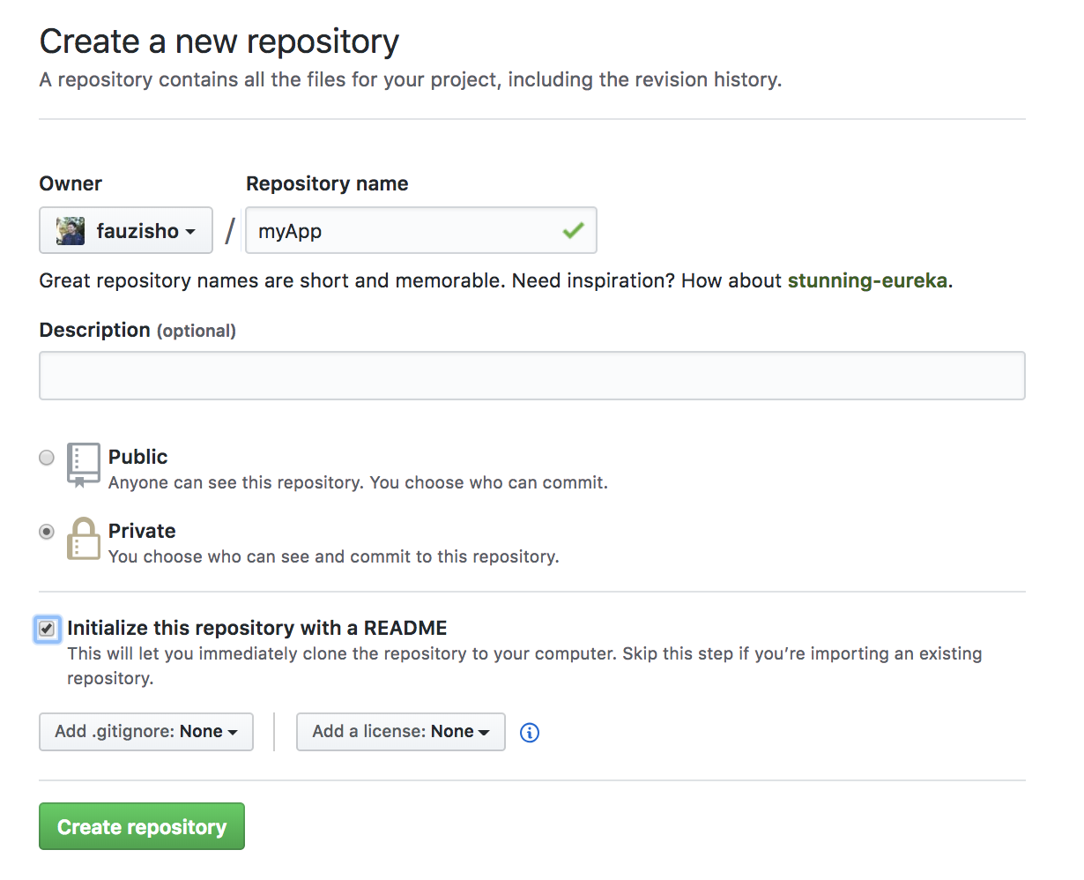
Github
4. Create new repository

Slide 9
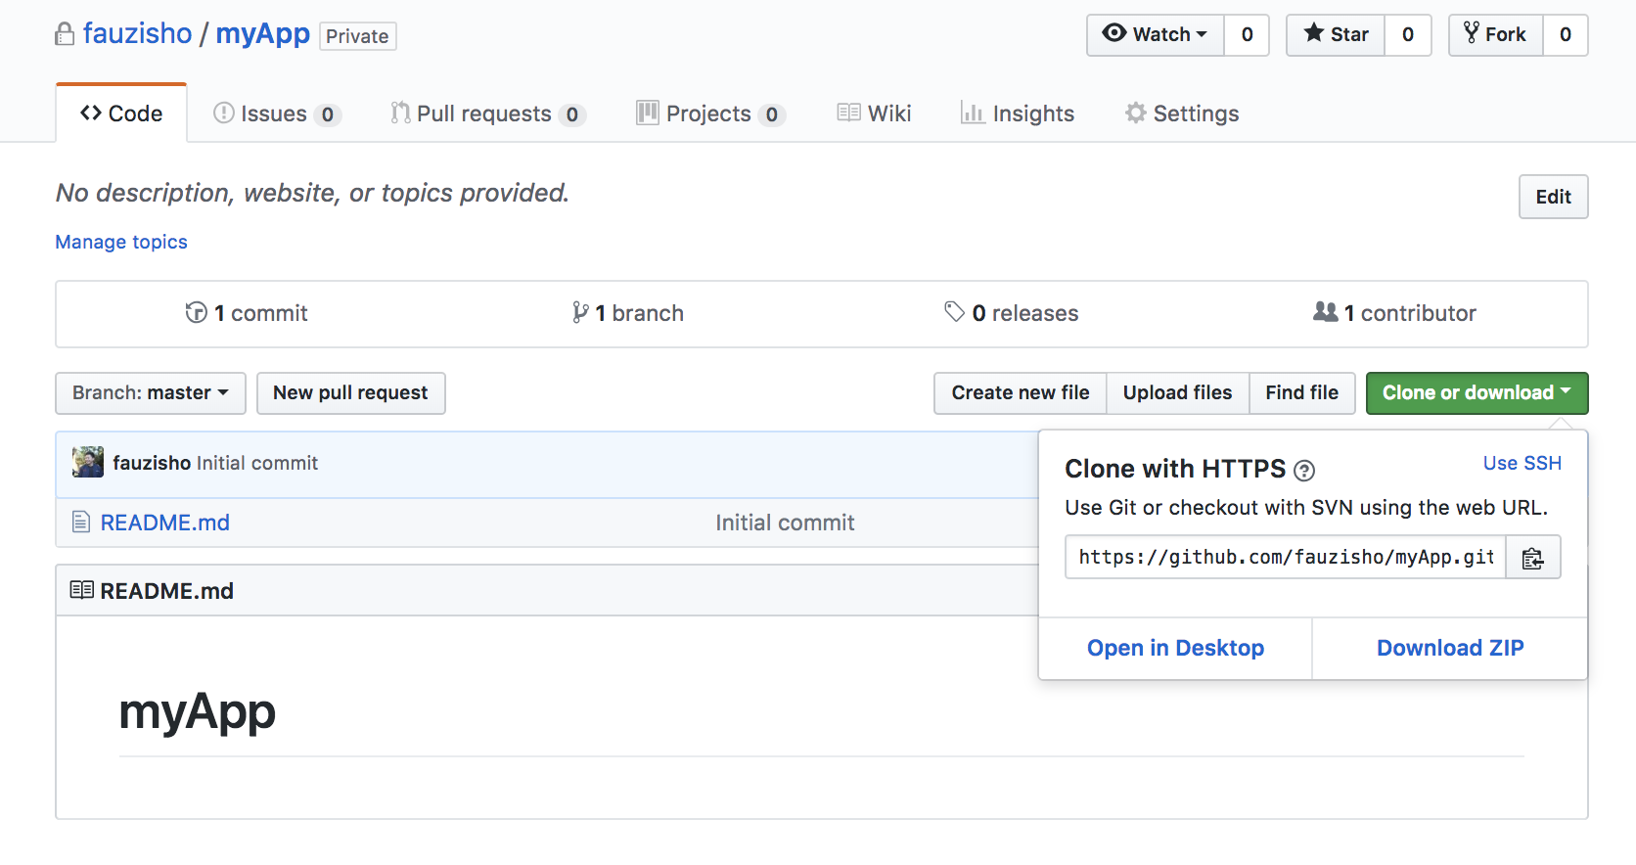
Get your HTTPS / SSH Access

Slide 10
Setup http/ssh access in your project
Open Terminal / CMD
Open your project in terminal
Check your repository access using :
git remote –v
Add your repository link :
git remote add origin …. (your link repository)
example :
git remote add origin https://fauzichin@bitbucket.org/fauzichin/myapp.git

Slide 11
Setup Git
Open Terminal / CMD
Open your project in terminal
Initialized empty Git repository in your folder using :
git init
Check your status folder using : git status
Add all file in one package using :
git add .
Add label of the changes file using (example : first commit) :
git commit –m “first commit”
Push on your repository
git push origin master

